Slide 1
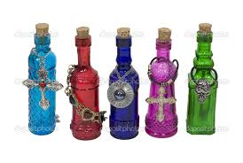
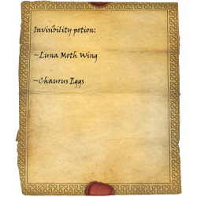
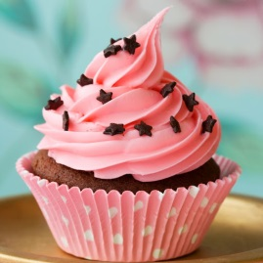
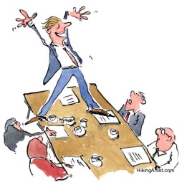
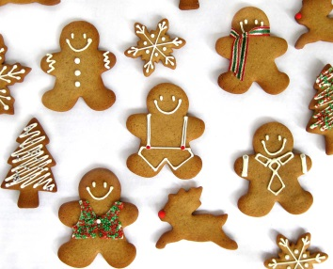
Home Learning Menu Year 4
Potions
Autumn Term 2
Write a magical potion recipe. It can be as weird and as wonderful as you can make it! | Design a potion bottle and label for a magic potion. | Cook a dish of your choice, practising your weighing and measuring skills.
Find a magical poem. Challenge: can you learn it by heart to perform to the class? | Share a magical story with a family member. Bring it in to share with class. | Design a science experiment that we could carry out during our science lessons.
Make a Christmas decoration to put up in the classroom. | Rewrite a Christmas song/poem. Challenge: make it into a rap! | Christmas cooking! Photograph what you have made.

Slide 2
Spellings Spelling rules to be taught this half term. Your child will be taught the rule for each pattern each week and then will be tested on 5 words involving that rule on a Wednesday.
Week: | 1 | 2 | 3 | 4 | 5 | 6
Rule: | Word ending with ‘tion’ | Prefix – words beginning ‘un’ | Suffix – words ending ‘ly’ | Homophones | Imperative verbs | Plurals
Spellings: | potion addition subtraction multiplication solution | unzip unable uneven unload unpack | magically wickedly evilly badly surprisingly | their they’re there where were | pour stir mix whisk boil | babies monkeys parties cherries turkeys
Challenge: |  | How many other words can you find and spell? | Can you think of any more words ending in ‘ly’ related to your topic. | Can you find any examples in your reading book? | Add ‘ing’ to these words. How does it change them? | How many Christmas words can you find ending in es, ies and s?

